Slide 1
Interactive digital Portfolio
CAPSTONE PROJECT
Presented by: Kuldeep Kirit Prajapati Drs. Kiran and Pallavi Patel Global University Vadodara (KPGU) Computer Science and Engineering

Slide 2
OUTLINE
Problem Statement
System Development Approach
Algorithm & Deployment
Result (code & output)
GitHub and Deployment Link
Conclusion
References

Slide 3
Problem Statement
Students and professionals often struggle to showcase their skills, projects, and achievements in an engaging way.
Traditional resumes and static portfolios are not interactive, visually appealing, or easily accessible.
There is a need for a dynamic and user-friendly online portfolio that effectively highlights individual skills and projects, while being easy to update and share.

Slide 4
Problem Statement
Lack of Engaging Presentation: Traditional resumes and static PDF portfolios are passive documents that fail to dynamically demonstrate technical skills or create a memorable impression on recruiters.
Ineffective Project Showcasing: It's challenging to present coding projects, designs, and achievements with the necessary context, visuals, and interactivity on a standard CV.
Accessibility & Shareability Issues: Physical resumes are limiting, and many portfolio solutions are not easily shareable with a single link or quickly accessible to global recruiters.
Static Nature: Updating a traditional portfolio with new skills or projects often requires cumbersome software or re-printing, making it inefficient to maintain.

Slide 5
Problem Statement
Inefficient Discovery for Recruiters: Recruiters lack a central, engaging hub to quickly evaluate a candidate's full range of work—including live project links, GitHub repositories, and case studies—without navigating multiple disjointed sources.
High Barrier to Maintenance: Many professionals avoid portfolio maintenance due to the perceived complexity of web development or the cost of platforms, causing their online presence to become outdated.

Slide 6
System Approach
Frontend Technologies:
HTML5 – Structure of the portfolio website
CSS3 – Styling and responsive layouts
JavaScript – Interactive elements (navigation, filtering, animations)
Design Approach:
Modern and minimal UI/UX design
Mobile-first responsive design
Clear separation of HTML, CSS, and JS files for modularity

Slide 7
System Approach
1. Core Technology Stack:
HTML5: Provides the semantic skeleton of the website, ensuring a logical structure, accessibility, and SEO-friendly foundation. Utilizes modern elements like <header>, <section>, <article>, and <nav> for clear content definition.
CSS3: Drives the complete visual presentation and user experience. Implements:
Flexbox & CSS Grid: For creating complex, responsive, and fluid layouts that adapt seamlessly to all screen sizes.
Custom Properties (CSS Variables): For maintaining a consistent theme (colors, fonts, spacings) and enabling easy future modifications.
Animations & Transitions: For enhancing user engagement with smooth scroll behaviors, hover effects, and section transitions.

Slide 8
System Approach
Key Features:
Semantic HTML for accessibility and SEO.
CSS Custom Properties for consistent theming.
Dynamic content rendering and DOM manipulation with JavaScript.
Smooth animations and transitions for enhanced UX.

Slide 9
Algorithm & Deployment
Portfolio Content Creation – Collect personal details, skills, projects, and achievements.
Frontend Design – Layout with HTML and CSS (sections for About, Skills, Projects, Contact).
Interactive Features – Smooth navigation, project filtering, modal views, contact form integration.
Testing – Browser compatibility, responsiveness on different devices.
Deployment – Host using GitHub Pages / Netlify for free and easy access.

Slide 10
Algorithm & Deployment
Content Strategy: Curated and structured all portfolio content, including bio, skill set, project case studies, and contact information.
UI/UX Design & Development: Built a fully responsive and visually appealing frontend with HTML and CSS, featuring a clean, intuitive layout.
JavaScript Interactivity: Developed core interactive features: smooth navigation, dynamic project filtering, modal pop-ups for project details, and a validated contact form.
Cross-Platform Testing: Ensured flawless performance and visual consistency across all major browsers and mobile devices.
Deployment & Hosting: Published the live site using Netlify/GitHub Pages for reliable, free hosting and streamlined update workflows.

Slide 11
Algorithm & Deployment
Portfolio Content Creation:
Action: Collected and organized personal details, skills, projects, and achievements.
Goal: To create a compelling narrative and ensure all information is targeted towards potential employers or clients.
Frontend Design & Architecture:
Action: Designed and implemented the layout with HTML and CSS, creating distinct sections (About, Skills, Projects, Contact).
Goal: To ensure a logical user journey, clear information hierarchy, and a professional aesthetic that aligns with modern web standards.

Slide 12
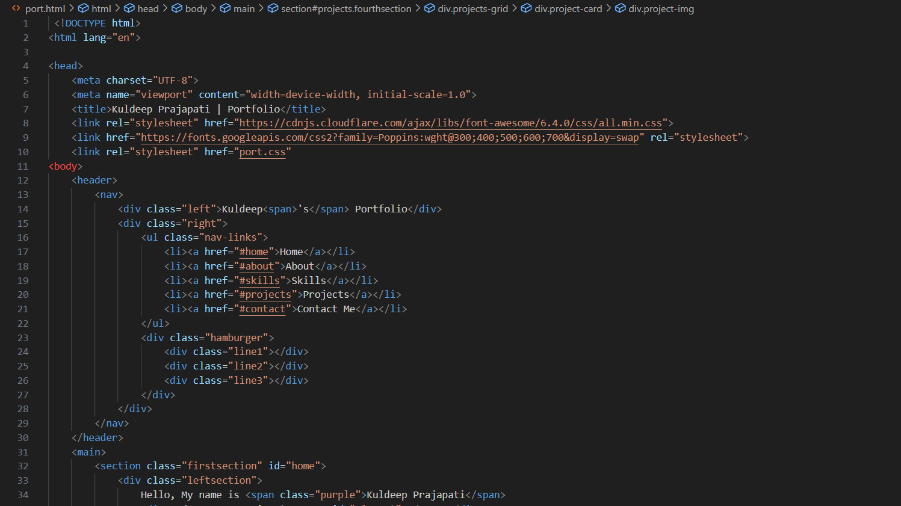
Result, Code(html)

Slide 13
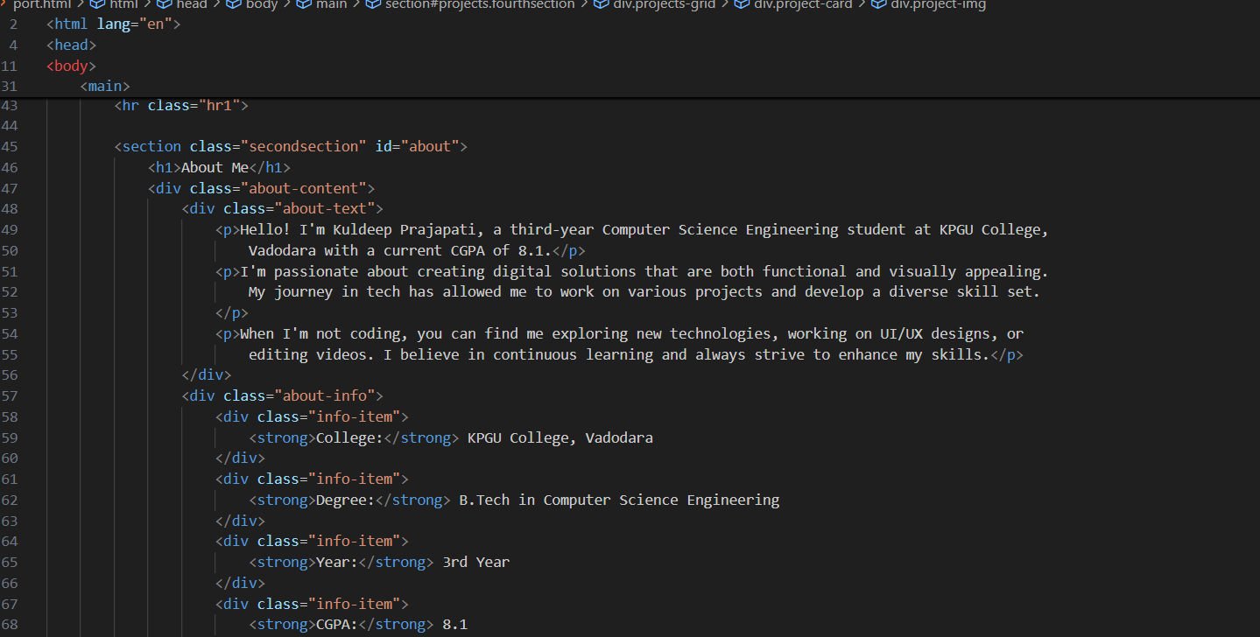
Code(html)

Slide 14
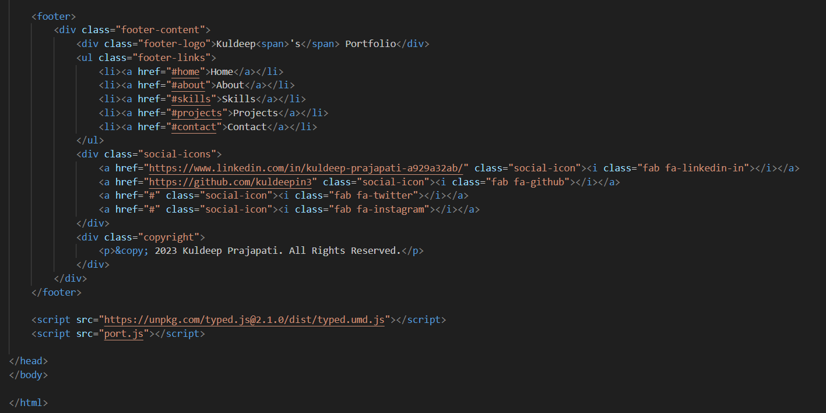
Code(html)

Slide 15
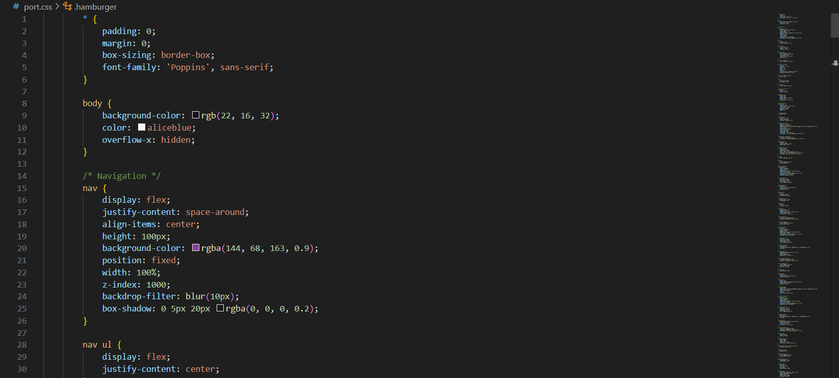
Code(css)

Slide 16
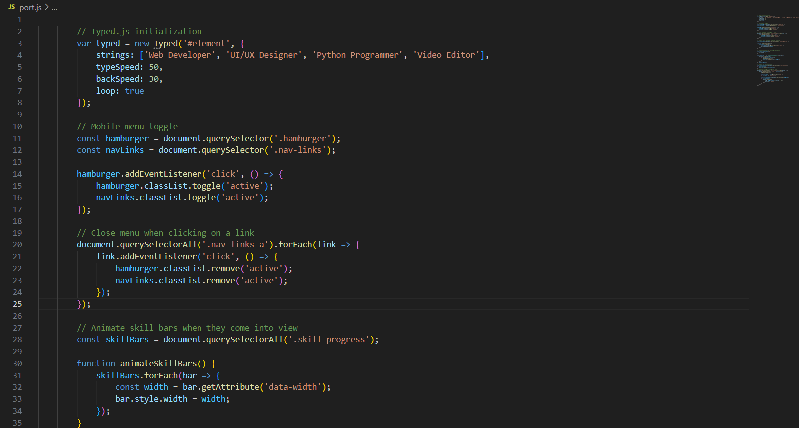
Code(js)

Slide 17
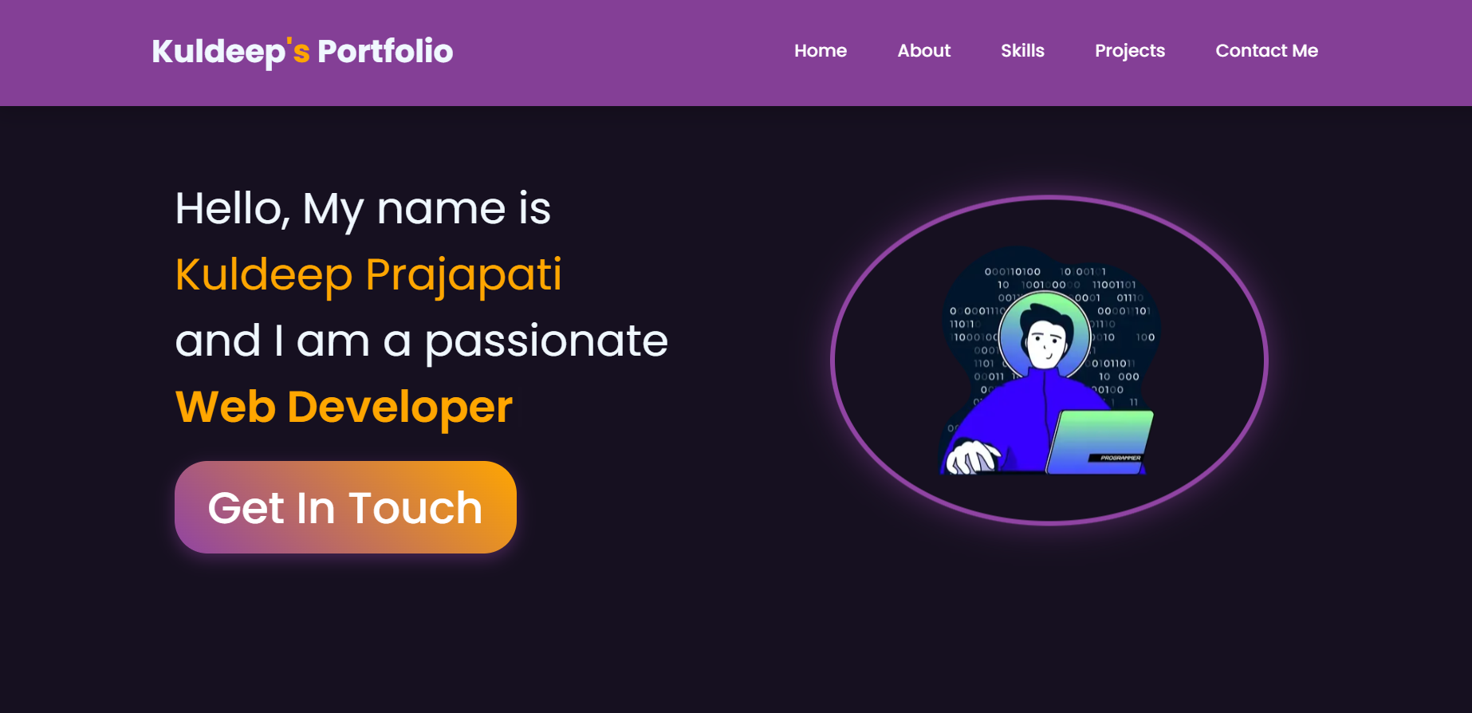
Output

Slide 18
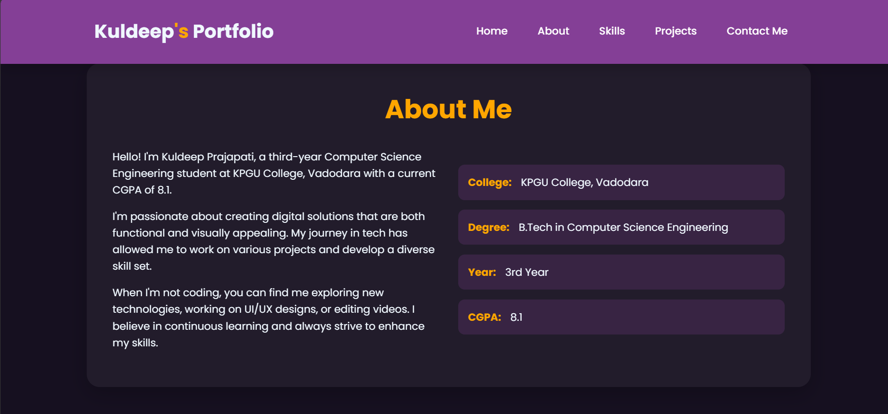
About me

Slide 19
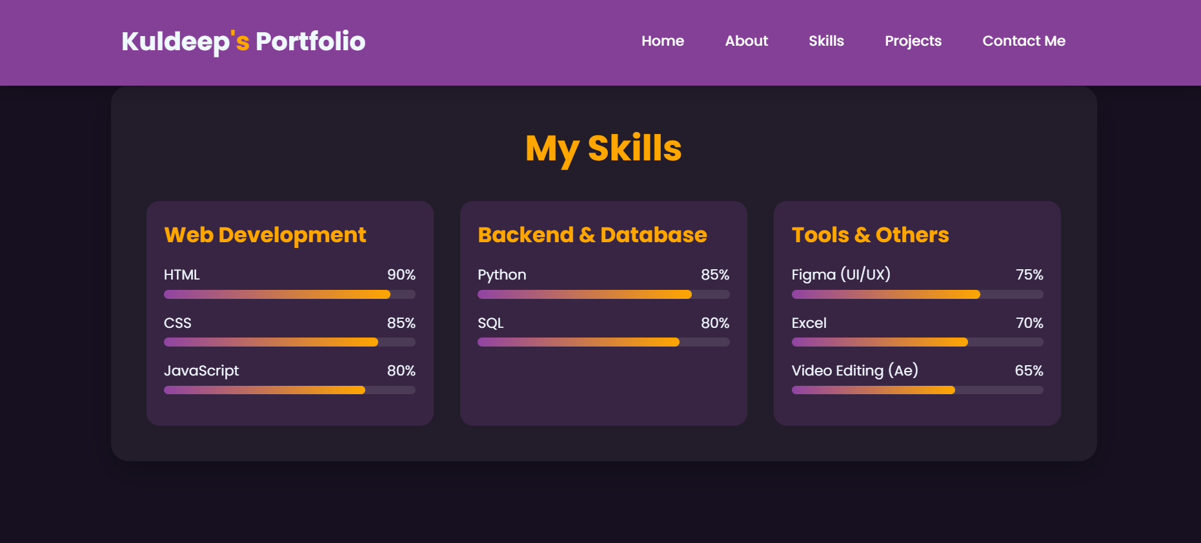
skills

Slide 20
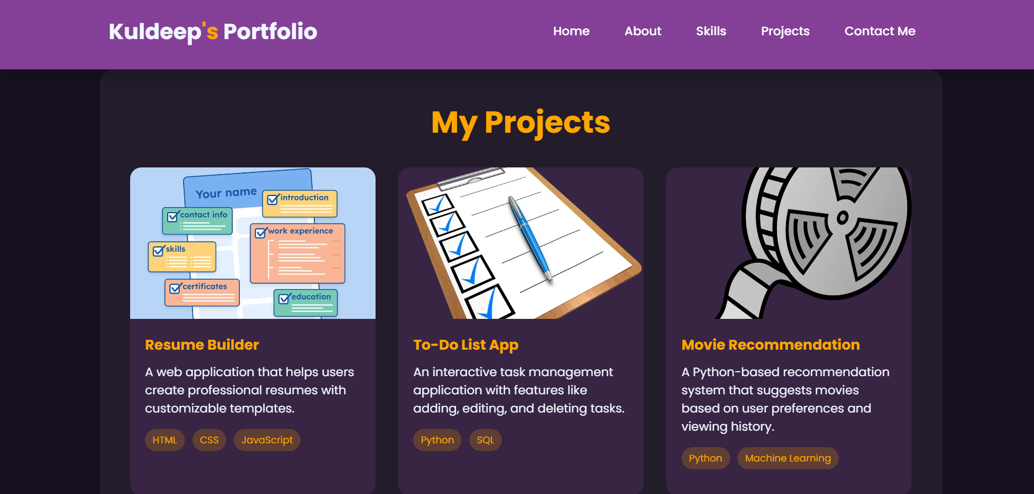
projects

Slide 21
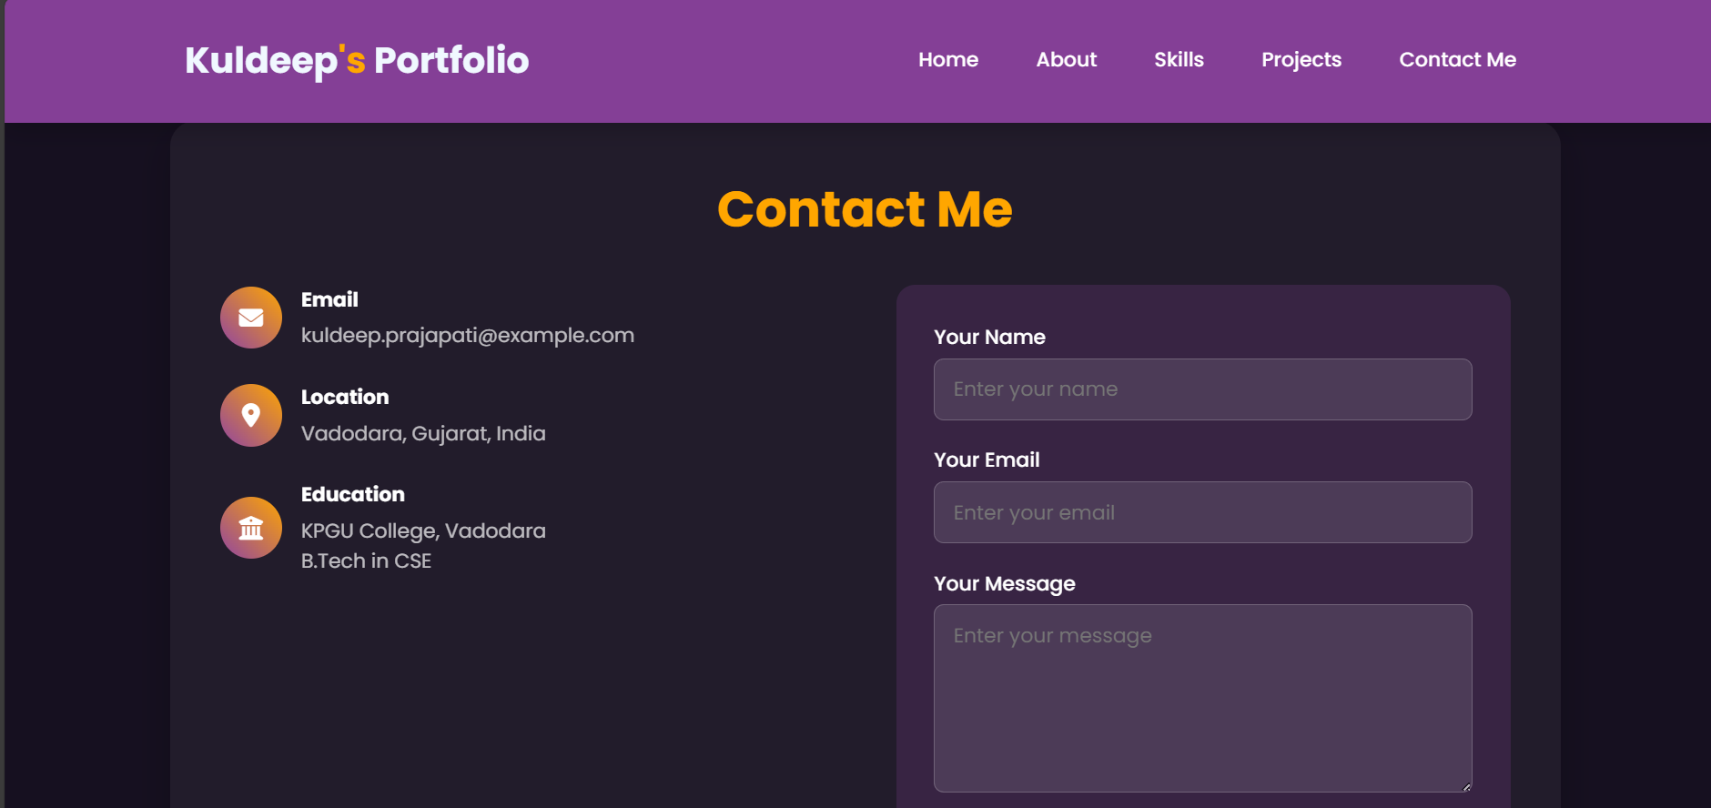
Contact me

Slide 22
GitHub and Deployment Link
GitHub Link: https://github.com/kuldeepin3/portfolio-capstone-edunet.git
Deployment link:
https://kuldeepin3.github.io/portfolio-capstone-edunet/

Slide 23
Conclusion
Provides a professional online presence.
Makes resumes more interactive and engaging.
Showcases projects, skills, and achievements effectively.
Easily shareable with recruiters and peers.

Slide 24
References
Bootstrap v5.3 Documentation
W3Schools HTML/CSS/JavaScript Resources
GitHub – Hosting Guides
FreeCodeCamp – Responsive Web Design Curriculum

Slide 25
THANK YOU

